Slide 1



Noida Institute of Engineering and Technology, Greater Noida
Rural Planning & Development
Unit: 2
Rural Development: Administration and Planning
Ajay Gangele
MBA
Department
BTECH 4TH Year (7TH Sem)
Unit 2

Slide 2

Faculty Profile
Faculty Name: Mr. Ajay Gangele
Designation: Assistant Professor
Department: MBA
Email ID: ajaygangele@niet.co.in
Qualification: MBA,UGC NET, Ph.D (P)
Specialisation: HR & Marketing
Total Experience:17+ years

Slide 3

Faculty Profile
Faculty Name: Mr. Ajay Gangele
Designation: Assistant Professor
Department: MBA
Email ID: ajaygangele@niet.co.in
Qualification: MBA,UGC NET, Ph.D (P)
Specialisation: HR & Marketing
Total Experience:17+ years

Slide 4

Index/Content
Index/ Content
S. No. | Index
1. | Name of Subject with code, Course and Subject Teacher
2. | Brief Introduction of Faculty member with Photograph
3. | Evaluation Scheme
4. | Syllabus
5. | Branch wise Application
6. | Course Objective(s)
7. | Course Outcome(s)
8. | Program Outcomes (POs)
9. | Cos and POs Mapping

Slide 5
Index/Content
Index/ Content
S. No. | Index
10. | Program Specific Outcomes (PSOs)
11. | COs and PSOs Mapping
12. | Program Educational Objectives (PEOs)
13. | Result Analysis
14. | End Semester Question paper Templates
15. | Prerequisite/Recap
16. | Brief Introduction about the subject with Video links
17. | Unit Contents
18. | Unit Objectives
19. | Topic/ Session Objectives

Slide 6
Index/ Content
Index/Content
S. No. | Index
20. | Lecture related to topic
21. | Daily Quiz
22. | Weekly Assignment
23. | Topic Links
24. | MCQs
25. | Glossary questions
26. | Old question papers
27. | Expected questions
28. | Recap of Unit

Slide 7
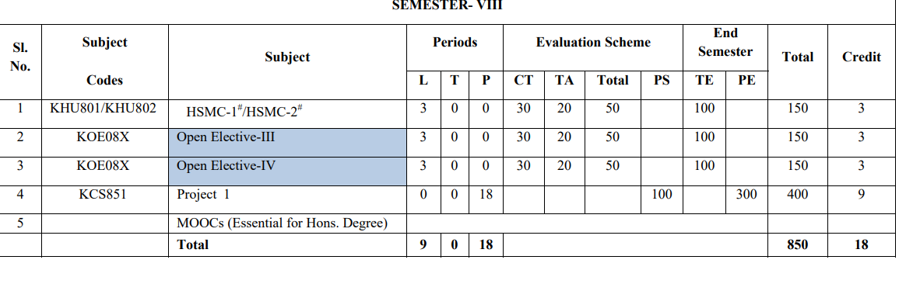
Evaluation Scheme

Slide 8
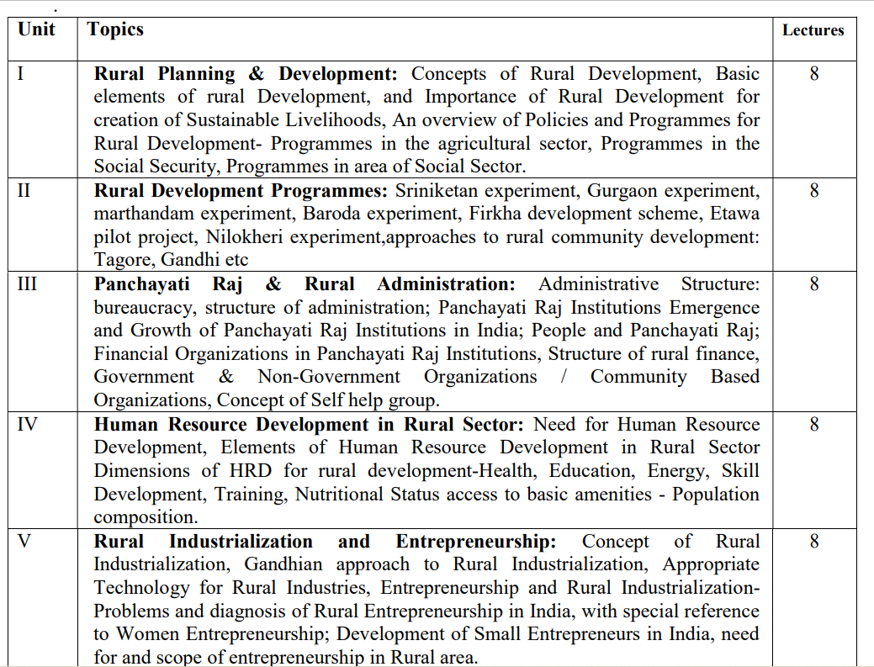
Syllabus
Syllabus

Slide 9
Branchwise Applications
Branch wise Applications
This course will help-
To know about the Indian culture and related education and to apply in society.
To understand the importance of Indian heritage, languages etc. and spread the knowledge in the society.
To understand the different religions, dialects, living standards of the people and make aware the society about the same

Slide 10
Course Objectives
Course Objectives
1.Students can understand the definitions, concepts and components of Rural Development
2. Students will know the importance, structure, significance, resources of Indian rural economy.
3. Students will have a clear idea about the area development programmes and its impact.
4. Students will be able to acquire knowledge about rural entrepreneurship.
5. Students will be able to understand about the using of different methods for human resource planning

Slide 11
Course Outcomes
CO1: Understand the definitions, concepts and components of Rural Development | Understand ( K 2)
CO2: Know the importance, structure, significance, resources of Indian rural economy. | Apply ( K 3)
CO3: Develop the ability to have a clear idea about the area development programmes and its impact. | Analyzing ( K 4)
CO4: Able to acquire knowledge about rural entrepreneurship. | Applying ( K 3)
CO5: Understand about the using of different methods for human resource planning | Understand ( K 2)

Slide 12
Program Outcomes
Program Outcomes
1. Engineering knowledge: Apply the knowledge of mathematics, science, engineering fundamentals, and an engineering specialization to the solution of complex engineering problems.
2. Problem analysis: Identify, formulate, review research literature, and analyze complex engineering problems reaching substantiated conclusions using first principles of mathematics, natural sciences, and engineering sciences.
3. Design/development of solutions: Design solutions for complex engineering problems and design system components or processes that meet the specified needs with appropriate consideration for the public health and safety, and the cultural, societal, and environmental considerations.
4. Conduct investigations of complex problems: Use research-based knowledge and research methods including design of experiments, analysis and interpretation of data, and synthesis of the information to provide valid conclusions.

Slide 13
Program Outcomes
Program Outcomes
5. Modern tool usage: Create, select, and apply appropriate techniques, resources, and modern engineering and IT tools including prediction and modeling to complex engineering activities with an understanding of the limitations.
6. The engineer and society: Apply reasoning informed by the contextual knowledge to assess societal, health, safety, legal and cultural issues and the consequent responsibilities relevant to the professional engineering practice.
7. Environment and sustainability: Understand the impact of the professional engineering solutions in societal and environmental contexts, and demonstrate the knowledge of, and need for sustainable development.
8. Ethics: Apply ethical principles and commit to professional ethics and responsibilities and norms of the engineering practice.

Slide 14
Noida Institute of Engineering and Technology, Greater Noida
Program Outcomes
Program Outcomes
9. Individual and team work: Function effectively as an individual, and as a member or leader in diverse teams, and in multidisciplinary settings.
10. Communication: Communicate effectively on complex engineering activities with the engineering community and with society at large, such as, being able to comprehend and write effective reports and design documentation, make effective presentations, and give and receive clear instructions.
11. Project management and finance: Demonstrate knowledge and understanding of the engineering and management principles and apply these to one’s own work, as a member and leader in a team, to manage projects and in multidisciplinary environments.
12. Life-long learning: Recognize the need for, and have the preparation and ability to engage in independent and life-long learning in the broadest context of technological change.

Slide 15



CO-PO Mapping
PO CO | P O 1 | P O 2 | P O 3 | P O 4 | PO 5 | PO 6 | PO 7 | PO 8 | PO 9 | PO 10 | PO 11 | PO 12
CO 1 | 2 |  |  | 2 |  |  |  |  |  |  |  | 2
CO 2 |  |  |  |  |  |  | 3 | 3 |  |  |  | 3
CO 3 |  | 2 |  |  |  |  |  | 3 |  |  |  | 2
CO 4 |  |  |  |  |  |  |  |  | 2 |  |  | 3
CO 5 |  |  |  |  |  |  | 2
Average | 0.4 | 0.4 | 0 | 0.4 | 0 | 0 | 1 | 1.2 | 0.4 | 0 | 0 | 2

Slide 16
Program Specific Outcomes
S.NO. | Program Specific Outcomes | PSO Description
1 | PSO1 | Ability to design manufacturing processes, products, the equipment, tooling and necessary environment for the manufacture of products that meet specific material and other requirements.
2 | PSO2 | Ability to use design, manufacturing and industrial engineering software packages to formulate and solve real time issues.
3 | PSO3 | Ability to analyze, synthesis and control manufacturing operations using statistical methods and to create competitive advantage through the application of manufacturing planning, strategy, quality and control concepts.

Slide 17
Program Educational Objectives
PEO1: able to apply sound knowledge in the field of information technology to fulfill the needs of IT industry.
PEO2: able to design innovative and interdisciplinary systems through latest digital technologies.
PEO3: able to inculcate professional and social ethics, team work and leadership for serving the society.
PEO4: able to inculcate lifelong learning in the field of computing for successful career in organizations and R&D sectors.

Slide 18
Result Analysis
Result Awaited

Slide 19
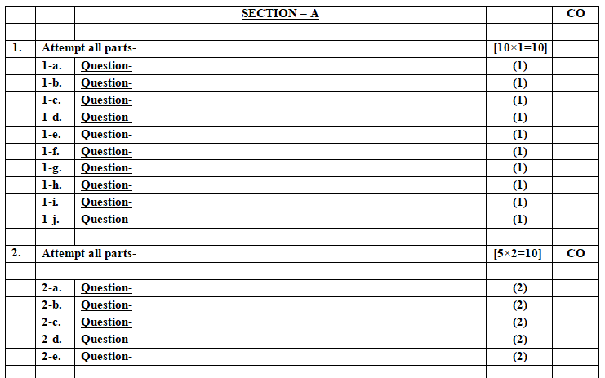
End Semester Question Paper Template
End Semester Question Paper Template

Slide 20
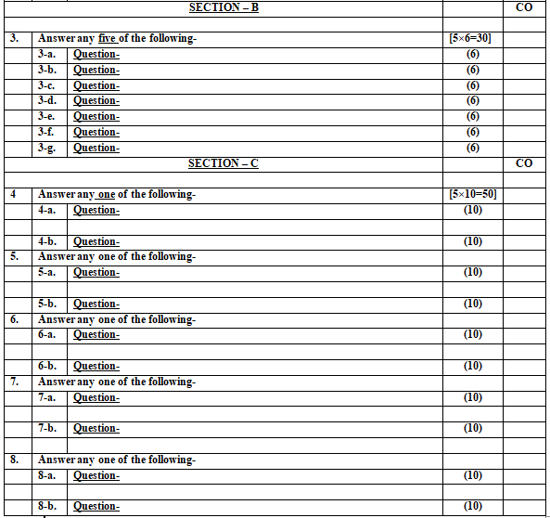
End Semester Question Paper Template
End Semester Question Paper Template

Slide 21
Pre-Requisites
Students should have a basic understanding of the Rural structure of the economy.

Slide 22
Introduction of subject with video links
Introduction of subject with video-links
Introduction of the subject with the help of few videos related to the rural structure of India.
https://www.youtube.com/watch?v=kVE0RaWAGCM
https://www.youtube.com/watch?v=2VFtjJy87Mc
https://www.youtube.com/watch?v=5Jif4nKDVxA
https://www.youtube.com/watch?v=z19BhR9hsjU
https://www.youtube.com/watch?v=z19BhR9hsjU&t=352s

Slide 23
Unit Content
Rural Development Programs:
Gurgaon experiment
Sriniketan experiment
Seva Gram and Marthadam Project
Baroda village construction and About Firkha Movement
Nilokheri and Etawa pilot project
Approaches to rural community development: Tagore, Gandhi etc.

Slide 24
Unit Objectives
To make students aware about rural development schemes.
To develop a clear understanding on different Pre-Independence rural development projects.
To develop a clear understanding on different Post-Independence rural development projects.

Slide 25

Noida Institute of Engineering and Technology, Greater Noida
(Unit –2) Topic 1
Gurgaon Project

Slide 26
Topic Mapping with course Outcomes
Unit-I | So. No. | Mapping
 |  | Topic | Course Outcomes
II | 1 | Introduction to Rural development | Co1
 | 2 | Pre-independence experiments | Co1
 | 3 | Post-experiment experiments | CO1

Slide 27
Topic Objectives
Students will be able to know the following concepts:
Introduction to Rural development and understanding of
Sriniketan Project
Marthandam Project
Gurgaon Experiment
Rural Reconstruction Programme by Mahatma Gandhi

Slide 28
Introduction
Pre Independence Period:
Sriniketan Project
Marthandam Project
Gurgaon Experiment
Rural Reconstruction Programme by Mahatma Gandhi

Slide 29
Introduction
Pre-Independence Era (1866-1947)
During the pre-independence era, various attempts were made by the individual persons and private agencies viz.
Gurgaon project in Haryana by Mr. F.L. Brayne; Sriniketan Experiment in Bengal by Sri Rabindra Nath Tagore;
Marthandam project by Dr. Spencer Hatch under the auspices of YMCA;
Sevagram experiment in Wardha by Mahatma Gandhi; Adarsh Seva Sangh, Pohri, Gwalior;
Indian Village Service in Lucknow and Etawah in Uttar Pradesh by Mr. A.T. Mosher and Sarvoday Programme in Bombay province by Sri B. N. Gupta were prominent.

Slide 30
Introduction
Continued……
It was during this period that the Department of Agriculture came into being in June 1871 under the then Government of India, and by 1882, agricultural departments in most of the provinces started functioning in skeleton form. Recognising the need for new and improved methods of cultivation based on agricultural research, the then Government of India also set up an Institute of Agricultural Research at Pusa in Bihar in 1905.

Slide 31
Gurgaon Project (1920)
Gurgaon Project (1920)
In Gurgaon district, this programme of village development was the first one to be run by the State. It was started by the Mr. F. L. Brayne. In 1920, Mr. Brayne had been appointed on the post of Deputy Commissioner in Gurgaon district and he began this project of rural upliftment in his district, which became famous as Gurgaon Project. Rural upliftment movement on amass scale was first started by Mr. F. L. Brayne. He was prompted by the backwardness, poverty and misery of the people. A village guide had been posted to act as a channel through which the advice of the experts in various departments could be passed on to the villagers.
The main objectives of this project were:
To deal with whole life of the village.
The work should be started in whole district at a time.
Development work should be taken at campaign level.

Slide 32
Gurgaon Project (1920)
The programme of introducing improved seeds, implements, the methods of cultivation etc. was started throughout the district. As the village guides were not technical men, very little permanent value was achieved in fact. The project could not develop leadership in the villages that would continue work when the village guides had left the villages
The main objectives of this project were:
(1) To increase crop production,
(2) to control extra expenditure,
(3) to improve the health,
(4) to develop the feeling of women-education, and
(5) home development work.

Slide 33
Area of work
Agriculture development and increasing food production.
Health improvement.
Village sanitation.
Social improvement.
Emphasis on women education.
Organization of cooperative societies.

Slide 34
Method of work
Propaganda was done by drama and music, to mould the human thoughts.
Guides were appointed to express the programme at village level and to help the rural people.
The teacher of village schools used to teach the village people the importance of programme and dignity of labor.

Slide 35
QUIZ
1. The most predominant sector of the Indian Economy , prior to independence was
Agriculture
Industry
Service Sector
Trade Sector
2. Which was the first census year of British India?
1991
1947
1881
1757
The …………………..sector had the largest share of workforce.
Agriculture
Industrial
External
None of the Above

Slide 36
RECAP
Gurgaon project and its activities for society.

Slide 37
Noida Institute of Engineering and Technology, Greater Noida
NOIDA INSTITUTE OF ENGINEERING AND TECHNOLOGY, GREATER NOIDA
Noida Institute of Engineering and Technology, Greater Noida
(Unit –2) Topic 2
Sriniketan Experiment

Slide 38
Objectives of Topic/Session
Students will be able to understand Shriniketan Project and its objectives.

Slide 39
Session Objective with CO mapping
To understand the importance of Rural Development programme like Sriniketan experiment.
Topic | Course Outcome
To understand the importance of Rural Development programme of Sriniketan experiment To understand the activities and area of work | CO2
39

Slide 40
The Sriniketan Experiment of Tagore
Rabindranath Tagore’s work in “village reconstruction” at Sriniketan is not as widely known as his work at Shantiniketan. Founded at Sriniketan in 1922, the Institute of Rural Reconstruction (IRR) was Tagore’s attempt to put to work his ideas about village reform.
Tagore has recalled how he, a “town-bred” individual, came to recognize the “sorrow and poverty of villagers” while being a manager of his family’s agricultural estates in East Bengal in 1890s.
In 1906, Tagore released his 15 point Village Reconstruction Charter in Pabna (now in Bangladesh). This document makes clear that making villages autonomous was chief among his concerns. It

Slide 41
The Sriniketan Experiment of Tagore
The object of Sriniketan is to bring back life in its completeness into the villages making them self-reliant and self-respectful, acquainted with the cultural tradition of their own country and competent to make an efficient use of modern resources for the improvement of their physical, intellectual and economic conditions.
The Objectives of the mission were:
To help the rural people for the development of cottage industry.
To develop their resources so that they may know new scientific methods of farming.
Development of cattle.
Development of multi purpose primary level education.
To help self help initiative and rural leadership.

Slide 42
Activities
Sanitation in villages.
Adult Education.
To arrange campaign for the eradication of Malaria, TB and other infectious disease.
To manage the pure drinking water.
To manage saving for famine and flood.
Development of Cottage industries.

Slide 43
Area of work
Sri Tagore started work in his Zamindari villages of Kaligram Perganna
for example- Atari, Raghupur, Rani nagar, Tilakpur, Latara etc.

Slide 44
Method of work
Survey of selected villages.
Foundation of social welfare centre in each village. Worker used to bring the rural problems upto this centre and solutions were provided to farmers. It was two way process.
To manage the medicines which may be available to rural people at proper time.
Demonstration of improved practices.
Community centers.

Slide 45
QUIZ
1. In rural India, the proportion of people still living in poverty is………
2/3
1/3
1/2
1/4
2. NABARD was set up in……………
1980
1981
1982
1983
3. The ‘Golden Revolution’ was a period of very high productivity in :
Food grain production
Horticulture
Organic farming
Pisciculture

Slide 46
RECAP
Sriniketan project
Gurgaon Project

Slide 47
Noida Institute of Engineering and Technology, Greater Noida
Noida Institute of Engineering and Technology, Greater Noida
NOIDA INSTITUTE OF ENGINEERING AND TECHNOLOGY, GREATER NOIDA
(Unit –2) Topic 3
Seva Gram and Marthadam Project

Slide 48
OBJECTIVES OF TOPIC/ SESSION
Briefly understand Seva Gram and Marthadam Project.

Slide 49
Session Objective with CO mapping
To understand the importance of Rural Development with the help of Seva Gram and Marthadam Project
Topic | Course Outcome
To understand the importance of Rural Development with the help of Seva Gram and Marthadam Project To understand the area and activity of its operations. | CO1
49

Slide 50
Marthandam Project (1928)
Marthandam Project (1928)
The work was commenced by Dr. Spencer Hatch an American Agricultural expert in Travancore under the auspicious of young Men’s Christian Association (YMCA) in 1921.
The villages in Marthandam area were undeveloped economically and the economic condition of the native majority was poor. Here, people used to cultivate only paddy and coconut on some places. For exploiting this weakness, it was thought that some developmental work should be done, so that the Christian faith could spread.
Consequently Dr. Hatch made agreement with YMCA and the Church for his work and initiated this project in neighbouring village Marthandam. The main objective of the project was to bring more abundant life for rural people.
It was intended to symbolize the three-fold development, not only spiritual, mental and physical but also economic and social.

Slide 51
Marthandam Project (1928)
The main objectives of this project were:
Spiritual development
Mental development
Physical development
Social development
Economic development

Slide 52
Seva-Gram (1920)
Seva-Gram (1920)
Self contained and self sufficient village life was the dream of Gandhiji.
He wanted to solve these problems by local people and through local resources. People know Gandhiji not only as a Mahatma or political agitator, but also as a social and economic reformer.
They focus on decentralized production and Self-sufficiency of Indian villages. key-words equal of his distribution economy of are: - wealth
For equal distribution of wealth, cruel process of extermination was not followed but throughout the heart of the owners by persuasion and appeal to the better sense of man.
Keeping these are in mind, Gandhiji began this welfare project SEVA GRAM establishing his Ashram in wardha, in 1920.

Slide 53
Seva-Gram (1920)
The main objectives of this project were:
to use khadi clothes
to introduce Health Program
the program of sanitation in the village
the program of women welfare,
the program of economic help
to uplift the backward classes
primary and adult educational programs
to improve the conditions of poor people
programs of social harmony and
to popularize the mother tongue and other national dialects.
Notes:
http://ecoursesonline.iasri.res.in/mod/resource/view.php?id=89022

Slide 54
Seva-Gram (1920)
The single cause of failure of Gandhiji’s program as stated by the scholars was industrialization in the country. Firka Vikas Yojana (1946) The government of Madras (now Tamil Nadu) decided to make efforts for the development of villages at Firka level. The first program began in 1946. Among Pre-Independence project, this was the biggest project. The Firka Development Scheme launched by Madras Government in 1946 aimed at the attainment of the Gandhian ideal of “Village Swaraj” by bringing about not only educational, economic, sanitary and other developmental activities of villages but also by revitalizing the spirit of the people and making them self-confident and self-reliant. Sarvodaya Scheme was launched by the Bombay Government with a view to promoting the furtherance of Gandhiji’s constructive programme.
Notes:
http://ecoursesonline.iasri.res.in/mod/resource/view.php?id=89022

Slide 55
QUIZ
1. ‘Organic farming’ was first suggested in india in:
1892
1982
1966
1995
2. The ‘Golden Revolution’ was a period of very high productivity in :
Food grain production
Horticulture
Organic farming
Pisciculture
3. Which of these schemes was established in 1988?
Kisan credit card
Self-help groups
Bharat Nirman
None of the above

Slide 56
RECAP
Sriniketan project
Gurgaon Project
Marthadam Project
Seva Gram

Slide 57
Noida Institute of Engineering and Technology, Greater Noida
Noida Institute of Engineering and Technology, Greater Noida
NOIDA INSTITUTE OF ENGINEERING AND TECHNOLOGY, GREATER NOIDA
(Unit –2) Topic 4
Baroda village construction and About Firkha Movement

Slide 58
OBJECTIVES OF TOPIC/ SESSION
Briefly understand the concept of Baroda village construction and About Firkha Movement.

Slide 59
Session Objective with CO mapping
To understand the importance of Baroda village reconstruction project.
To understand the of objective of Firkha Movement.
Topic | Course Outcome
To understand the importance of Baroda village reconstruction project, its scope and working style. To understand the of objective of Firkha Movement. | CO2
59

Slide 60
Baroda village reconstruction project (1932)
Baroda village reconstruction project (1932)
Shree B.T. Krishnamachari in Baroda in the Gujarat State initiated this Project in 1932. This Project Continued for a long period.
Objectives
The aim of the movement as follows:
The centre should aim at effecting an improvement in all aspects of rural life changing in fact the outlook of the Agriculturists, the target being creating desire for a higher standard of living.
Village leadership of the best type should be developed.

Slide 61
Baroda village reconstruction project (1932)
Scope
This Project was started in the district of Navsari in the Gujarat State.
Many programmes such as gardening, poultry-farming, bee-keeping, spinning and weaving were organized.
Re-stabilization of Panchayats and other programmes of village progress were organized.
The adult education had been extended.
Working System
By personal education and contact by the village guides.
To use the school teacher of village in the extension of programme.
To use the traditional means of extension.

Slide 62
The Firka Development Scheme
The Firka Development Scheme
The Firka Development scheme of Madras was a Government sponsored Scheme in 1946 this programme aimed at organizing the villagers for a Happier, more prosperous and fuller life in which the individual villagers had the opportunity to develop both as an individual and as a unit of a well-integrated society.
The main objective is:
To tackle the rural problem as a whole.
Formation of Panchayats and organization of cooperatives.
Long term plan to make the area self sufficient through Agricultural, irrigational and livestock improvement.
Development of Khadi and cottage industry.

Slide 63
QUIZ
1. Which among the following is an initiative taken for the development of rural India?
Human capital formation
Land reforms
Poverty alleviation
All of these
2. The duration of short-term credit is………….
6-12 months
2 to 5 years
5 to 20 years
12 months to 5 years
3. The duration of long-term credit is…………
6-12 months
2-5 years
5-20 years
12 months to 5 years

Slide 64
RECAP
Sriniketan project
Gurgaon Project
Seva Gram
Marthadam Project
Baroda reconstruction Project
Firkha Movement

Slide 65
Noida Institute of Engineering and Technology, Greater Noida
NOIDA INSTITUTE OF ENGINEERING AND TECHNOLOGY, GREATER NOIDA
(Unit –2) Topic 5
POST-INDEPENDENCE EXTENSION AND RURAL DEVELOPMENT PROGRAMMES like
NILOKHERI and ETAWAHA project

Slide 66
OBJECTIVES OF TOPIC/ SESSION
To understand POST-INDEPENDENCE EXTENSION AND RURAL DEVELOPMENT PROGRAMMES like
NILOKHERI and ETAWAHA project etc.

Slide 67
Session Objective with CO mapping
To understand the importance of projects like Nilokheri , Etawah, CDP, NES and CDB.
Topic | Course Outcome
To understand the importance of projects like Nilokheri , Etawah, CDP, NES and CDB. | CO2
67

Slide 68
POST-INDEPENDENCE EXTENSION AND RURAL DEVELOPMENT PROGRAMMES
Introduction
The urgent need for stepping up food production was realized even in the pre-Independence era and a Grow-More-Food Campaign was started. Under the campaign, targets for increased agricultural production were laid down for the first time on an all-India basis. But the campaign failed to achieve its targets.
Soon after Independence (1947), the Central Government re-defined the objectives of the Grow-More-Food Campaign as the attainment of self-sufficiency in food grains by 1952, and simultaneously increased the targets of production of other crops to meet the shortfall as a result of the partition of the country. At the same time, arrangements were made for integration and co-ordination of the entire campaign for increasing agricultural production.

Slide 69
POST-INDEPENDENCE EXTENSION AND RURAL DEVELOPMENT PROGRAMMES
Accordingly, some initiatives in this direction were taken, which are given as under:
Community development
Year | Programme/scheme | Person/agency/ approach
1948 | Nilokheri experiment (Mazdoor Manzil) | Shree S. K. Dey
1948 | Etawah pilot project | Albert Mayer
1952 | CDP | Community Development Programme
1953 | NES | National Extension Service
1954 | CDB | Community Development Block
1957 | Panchayati Raj | Panchayati Raj Democratic Decentralization

Slide 70
Etawah pilot project (1948)
Etawah pilot project (1948)
The idea of intensive all-round development work in a compact area was put into practice as a Pilot Project in Rural Planning and Development in the Etawah District in Uttar Pradesh in 1948, which can be regarded as a forerunner of the Community Development Project in India.
Albert Mayer, an American Engineer, played the key role in the initiation and implementation of the project. The program was based on the principle of self-help, democracy, integrated approach, felt needs of the people, rigorous planning and realistic targets, institutional approach, co-operation between governmental and non-governmental organizations.
The second name of this project is “ Average district project”started in 1947.
Objectives:
To develop the mental power of people.
Arousing their interest and initiative.
Improving crops and livestock.
To encourage panchayats.
To build up the sense of self help in villagers.

Slide 71
Nilokheri experiment (1948)
Nilokheri experiment (1948)
Shree S. K. Dey, was the founder of the Nilokheri Experiment, when nearly 7000 displaced persons from Pakistan and later integrated with the 100 surrounding villages in to what came to be rural-cum-urban township.
It was built round the vocational training centre Nilokheri, in July 1948. Shree Dey began this project using 1100 acre of swampy land spreading in the midst of Karnal and Kurukshetra.
Shree Dey went on to become the Union Minister of Community Development in 1965. The scheme was also known as "Mazdoor Manzil" because of its principle 'he who will not work, neither shall he eat'.
It was started to settle the 7000 displaced persons and later integrated with 100 villages surrounding Nilokheri. This scheme was called “Mazdoor Manzil”.
Objectives:
Self sufficiency for rural cum urban township in all essential requirements of life.
Making provision of work and training for the people according to their native background.
To check middle men.
To enable transactions between the consumer and the producer, to approach a vertical order.

Slide 72
Nilokheri experiment (1948)
Nilokheri experiment (1948)
Objectives:
Self sufficiency for rural cum urban township in all essential requirements of life.
Making provision of work and training for the people according to their native background.
To check middle men.
To enable transactions between the consumer and the producer, to approach a vertical order.

Slide 73
Community development project (1952)
Community development project (1952)
As a result of the Grow-More-Food Enquiry Committee Report and the successful experience of the Etawah Project, 15 Pilot Projects were started in 1952 in selected states with the financial assistance received from the Ford Foundation.
Besides helping to increase agriculture production and bettering the overall economic condition of the farmers, these projects were meant to serve as a training ground for the extension personnel.
It was soon realized that for the creation of an urge among the rural population to live a better life and to achieve permanent plentitude and economic freedom in the villages, a much bolder and dynamic effort was called for.
It was recognized that the success of this new effort depended upon and whole hearted co-operation of the beneficiaries, government officials and non-officials at every stage, the education of rural masses in the technique of rural development and the timely provision of adequate supplies of the needed inputs and other requirements.

Slide 74
Grow-more-food enquiry committee report (1952)
Grow-more-food enquiry committee report (1952)
Though efforts were made to revitalize the Grow-More-Food Campaign, it was observed that the system was not functioning properly and the cultivator's response to the program was very poor.
As a result, the Government of India in 1952 appointed a committee known as the GMF Enquiry Committee to examine the working of the Grow-More-Food Campaign.
The findings of this Committee revealed that the problem of food production was much wider than the mere elimination of food imports and that agricultural improvement was a very important part of a much wider problem of raising the level of rural life in the country. The committee also pointed out that:
All aspects of village life were interrelated,
Improvement could be brought about by a number of detached program operating independently,
There was lack of unity of efforts,
The available finances was not adequate

Slide 75
Grow-more-food enquiry committee report (1952)
The movement did not arouse nation-wide enthusiasm and did not become a mass movement for raising the level of village life.
In its recommendations, the Committee proposed the formation of development block, each consisting of 100 to 120 villages, and the appointment of revenue officers as development officers or extension officers, assisted by technical officers for agriculture, animal husbandry, co-ordination and engineering. For actual work in villages, the Committee suggested the appointment of one village level worker for every five or ten villages.
The Committee also described broadly the functions of the extension service, the manner in which the extension organisation would operate, the arrangements required in training of the required staff, the way in which the non-official leadership should be associated with the work of village development at the village, taluka, district and state levels.

Slide 76
Grow-more-food enquiry committee report (1952)
Based on these recommendations, the Planning Commission, which was set up earlier by the Government of India to prepare a plan for development consistent with the available resources, gave the highest priority to the development of agriculture and irrigation in the First Five-Year Plan.
The Commission fixed substantially high targets of internal production and decided, as recommended by the Enquiry Committee, that the drive for food production should form part of plans for overall agricultural development, and that agricultural improvement in its turn should form an integral part of the much wider efforts for raising the level of rural life.
The Commission prescribed "Community Development" as the method for initiating the process of transformation of the social and economic life of villages and "Rural Extension" as its agency.

Slide 77
National extension service (1953)
National extension service (1953)
The National Extension Service was inaugurated on 2nd October 1953. The scheme of National extension service was designed to provide the essential basic staff and a small fund for the people to start the development work essentially on the basis of self-help.
The operational unit of this service was an N.E.S. block comprising about 100 villages and 60,000 to 70,000 people. The N.E.S. blocks were later converted into community development blocks which had higher budget provisions in order to take up more intensive development programmes.
The pattern of community development programme was further revised (modified with effect from 1st April 1958).
According to this pattern, there were four stages:
Pre-Extension Stage
Stage I Blocks
Stage II Blocks
Post-Stage II Blocks

Slide 78
Key village scheme (1952)
Key village scheme (1952)
Key Village Scheme launched in August 1952 was the first systematic attempt to improve the quality and productivity of cattle and buffaloes in the country.
It was proposed with a view to promote intensive cattle development in compact areas by utilising the limited quantity of high quality breeding stock.
Basic objective of the scheme is the rapid multiplication of crossbred cattle for meeting the acute shortage of high quality animals by grading up of the indigenous cattle population.
Gradually it embraced all the major aspects of cattle development such as superior breeding, castration of scrub bulls, fodder development, control of diseases, maintenance of records, milk recording and marketing of livestock and livestock products.
Notes:
http://ecoursesonline.iasri.res.in/mod/resource/view.php?id=89026

Slide 79
QUIZ
1………………….is an important source of occupation for the women.
Fishing
Agriculture
Livestock farming
Horticulture
2. ……………………..is an assurance to the farmers that their product would be purchased by the government at the specific price.
MSP
MRP
Both a and b
None of these
3. In distress sale farmers sell their product at …………….prices in the market.
High
low
undetermined
None of the above

Slide 80
RECAP
Etawah pilot project
Nilokheri Project
Community development project
Grow-more-food enquiry committee report
National extension service

Slide 81
Noida Institute of Engineering and Technology, Greater Noida
NOIDA INSTITUTE OF ENGINEERING AND TECHNOLOGY, GREATER NOIDA
(Unit –2) Topic 6
Approaches to Rural development.

Slide 82
OBJECTIVES OF TOPIC/ SESSION
To understand the concept of different approaches to Rural development.

Slide 83
Session Objective with CO mapping
To understand different approaches of Approaches to rural development.
Topic | Course Outcome
To understand different approaches of Approaches to rural development. | CO2
83

Slide 84
Approaches to Rural Development
The types of approaches to rural development are as follows:
Broad front Approach:
Sectoral Approach:
Participatory Approach:
Area Development Approach:
Target Approach:
Basic Needs Approach:
Employment-oriented Integrated Approach to Rural Development:
Integrated Development Approach:
Growth Center Approach:
Community-driven development (CDD) or Approach:

Slide 85
Broad Front Approach
Community Development and Panchayat Raj were often described as *Broad-front’ or ’Multipronged* development strategies as they aimed at development of villages covering all the major spheres like Agriculture, Animal Husbandry, Rural Industries, Communication, Health, Education, Women Welfare and Social Welfare(Desai, 1983).
In the early 1960*s India revised its rural development strategy and adopted sectoral approach of development, due to financial limitations and pressing needs and priorities (Sharma, 1977)*
In the process, it launched specific sectoral development programmes such as Intensive Agricultural District Programme, Intensive Agricultural Area Programme, Intensive Cattle Development Programme, etc.

Slide 86
Broad Front Approach:
In early fifties, rural development efforts began with multi-purpose approach which included activities related to agriculture, animal husbandry, co-operation, irrigation, village and small scale industries, health, sanitation, housing, transport and communication, welfare of women and rural employment.
The critics also point out that;
It brought about a great disparity between the rich and the poor, ii)
It hardly touched the problem of meeting the felt needs of the people, iii)
It failed to bring about the process of modernization through social education, and iv)
Lack of people’s participation. In spite of the criticisms leveled against CDP and NES, the fact cannot be denied that the programme added a new dimension to the process of change and generated community consciousness to solve community problems.
46 The multi-purpose approach was a significant approach, which laid the foundation stone for the upliftment of rural India.

Slide 87
Sectoral Approach:
Sectoral development planning in individual sectors like education, health, housing and social security are included in sectoral approach of development.
This approach advocates compartmentalization of development in different sectors as if these are watertight compartments and have nothing to do with each other.
By 1960’s the situation was rather critical on the food front. The need for great concentration on food production led to strategy for locating potential sectors and well endowed districts and areas capable of yielding higher agricultural production.

Slide 88
Participatory Approach:
This concept has been developed from participatory development. “Participatory development is a process through which stakeholders can influence and share control over development initiatives, and over the decisions and resources that affect themselves”(ADB, 1996).
• A process to engage local populations in development projects.
• PD uses local decision making and capacities to steer and define the nature of an intervention.
• PD aims at achieving a localized capital accumulation process based on the skills development and local resources generation.
• The essential feature of PD is social mobilization
• PD gives a new self-confidence through which the community can engage in more ambitious projects involving collective action and management.

Slide 89
Area Development Approach:
This approach contemplates that development of an area depends not only on the development of an adequate infrastructure network but also the way factors of the local economy are activated around the production infrastructure.
In other words, for development of an area, spatial and functional integration is necessary. Thus, while rural growth centers provide ideal locations for the provision of infrastructural facilities, their hinterlands are regarded as basic planning units for integrated multi-sectoral planning to achieve integrated development of an area.
The approach, while taking area poverty into consideration, provides a balance between various sectoral activities as well as spatial pattern of growth; however, it does not ensure that economic growth is being shared by all classes and communities of the rural areas.

Slide 90
Target Approach:
In order to accommodate the lagging sectors/regions rural development was reconceptualized to highlight the improvement of the social and economic life of a specialized group of people.
The target group comprised of marginal and small farmers, landless agricultural labourers for whom special programmes such as Small Farmer Development Agency 47 (SFDA) and Marginal Farmers Development Agency (MFALDA) were started.
It was noticed that the target group approach showed a better results where information facilities were satisfactory and administrative and organizational arrangements were reasonably strong.
This approach was for the correction of regional imbalance. In this connection, mention may be made of Tribal Area Development Programme (TADP, 1972), Hill Area Development Programme (HADP, 1974-75), Drought Prone Area Programme (DPAP, 1970), Desert Development Programme (DDP, 1977-78), and Command Area Development Programme (CADP, 1975). These programmes were fairly successful in terms of implementation.

Slide 91
Basic Needs Approach:
The basic needs approach gives primacy to the need for a minimum standard of living of the poor as a central concern of development planning. It therefore contributes to the formulation of a development strategy, which aims at reducing poverty and inequality, promoting growth of employment and distributive justice. The basic needs concept is a wider scope covering personal and social consumption and also human rights, peoples participation, employment and growth with justice. 48 The Minimum Needs Programme (MNP) in India was introduced in 1974 during the first year of fifth plan period.
The main components of MNP are:
Rural health,
Rural education,
Rural roads,
Rural drinking water,
Rural electrification,
House sites for landless,
Environmental improvement in slums, and
Nutrition.
SHRUTI SHARMA KHU701_RD Unit 2

Slide 92
Employment-oriented Integrated Approach to Rural Development:
With a view to overcome the limitations of earlier approaches and to improve the quality of life of the poor living in the rural areas, a multilevel, multi-sector, with multisection concept of integrated rural 49 development was launched in 1978-79.
The different programmes were brought under single umbrella of Integrated Rural Development Programme (IRDP). It aimed at ensuring accelerated welfare and development of the poorest of the poor based on Gandhian concept of Antyodaya. Several programmes for providing employment to rural poor, namely, rural works programme, rural employment guarantee programme, IRDP, Training Rural Youth for Self-Employment (TRYSEM), Development of Women and Children in Rural Areas (DWCRA) and Jawahar Rozgar Yojana (JRY) were introduced.

Slide 93
Integrated Development Approach:
In the context of problems in the area development approach to tackle the problems of rural poverty, a new strategy of development, i.e. the integrated development approach has been developed because the area development approach by and large failed to address the question of inequalities in the distribution of employment, incomes and assets.
The Indian economy and social structure are characterized by widespread poverty, poor health conditions, illiteracy, exploitation, inequitable distribution of land and other assets and lack of infrastructure and public utilities (roads, communications etc).
The concept of “integrated rural development” came into vogue with the need for a multipurpose thrust to rural planning. It stresses that various facets of rural development, which have an impact on rural life, are interrelated and cannot be looked at in isolation.

Slide 94
Growth Center Approach:
It is most appropriate for planning integrated rural development. Based on the principle of “equal accessibility”, this approach can bring all these facilities,
The growth center should be equipped with all the required facilities such as:
[a] Training center to impart practical training and build capacity to enhance productivity of agriculture and rural/cottage/agro-based industries
[b] Mobile training-cum-demonstration unit to provide on the spot training, repair and maintenance, services for agricultural and industrial machineries
[c] Marketing-cum-warehousing facilities that can provide safe storage and marketing of farm produce and cottage industries products
[d] Forest and grass nursery to provide fruits, fuel, fodder and forest cover
[e] Developmental school based on the “ earning while learning principle” and oriented to develop a cadre of self-employed workers in the area of human, animal, plant and soil-health care and
[f] Residential housing complex for workers in the project area.

Slide 95
QUIZ
……..means giving small loans to individuals for eatablishing self-employment.
Macro credit
Micro credit
Both a and b
None of these
2. Which Indian state has been held as a success story in the efficient implementation of milk cooperatives?
Punjab
Gujarat
Uttar Pradesh
west Bengal

Slide 96
QUIZ
The problem faced in rural banking are……….
Insufficient rural credit
Growing overdue
Inadequte amount of sanction
All of these.
4. The problem faced in rural banking are……….
Insufficient rural credit
Growing overdue
Inadequte amount of sanction
All of these.

Slide 97
VIDEO-LINK
https://www.youtube.com/watch?v=kVE0RaWAGCM
https://www.youtube.com/watch?v=2VFtjJy87Mc
https://www.youtube.com/watch?v=5Jif4nKDVxA
https://www.youtube.com/watch?v=z19BhR9hsjU
https://www.youtube.com/watch?v=z19BhR9hsjU&t=352s

Slide 98
Assignment
What is rural development? ...
What is meant by agricultural diversification? ...
What is TANWA? ...
What is 'Golden Revolution'? ...
Write two instruments to safeguard the interests of farmers by the government.
What is cooperative marketing? ...
What do you mean by 'Operation Flood'?

Slide 99
MCQ’s
1. The problem faced in rural banking are:
a) Insufficient rural credit b) Growing overdue c) Inadequate amount of sanction d) All of these
2. The Scheme of “Micro Finance” is extended through
a) Self Help groups b) Land Development Banks c) NABARD d) Regional Rural Banks
3. Why is the minimum support price fixed by the government?
a) For government own benefit b) To safeguard the interest of farmers c) To safeguard the interest of consumers d) None of these
4: Agriculture marketing does not comprise of
a) Transportation of the produce to the marketplace for sale b) Grading of the produce according to the quality c) Storage of the produce for sale in future d) Credit took to meet expenditure on agriculture

Slide 100
MCQ’s
MCQs
4. Which of the following is a non-farm area of employment?
a) Livestock farming b) Horticulture c) Fisheries d) All of the above
5. White Revolution is associated with:
a) Horticulture b) Fisheries c) Dairying d) Animal Husbandry
6. The period between___________is known as ‘Golden Revolution Period’
a) 1991-2001 b) 1991-2003 c) 1993-2001 d) 1990-2003

Slide 101
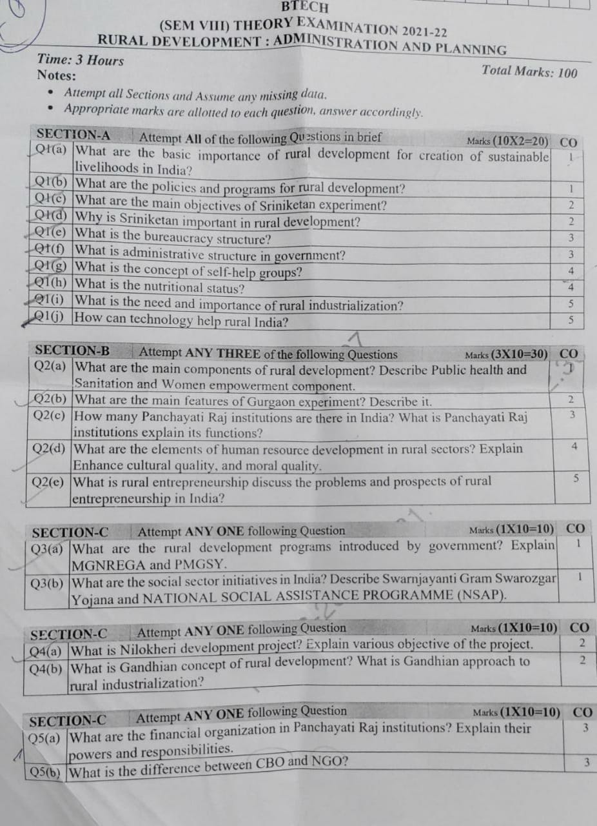
University Paper

Slide 102
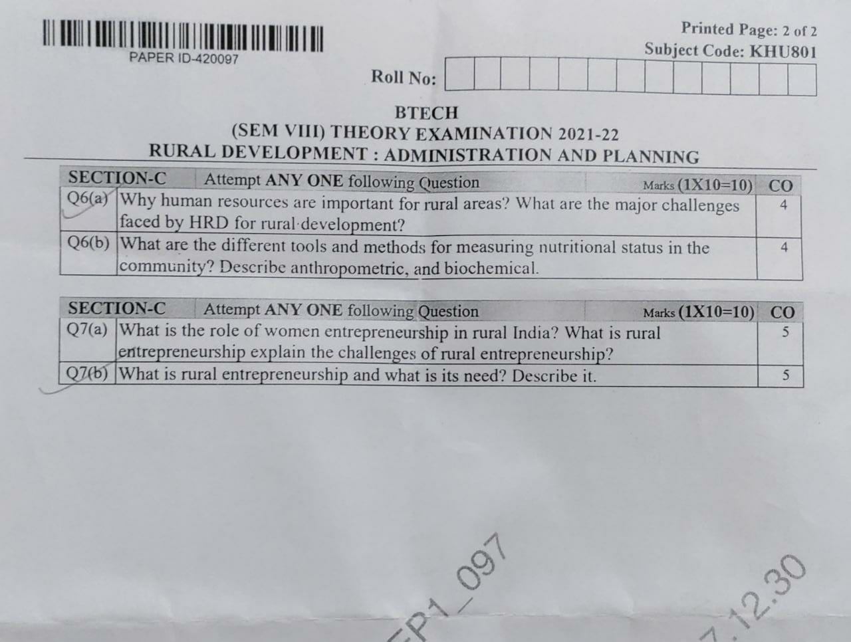
University Paper

Slide 103
Expected questions for University Exams
Define rural development.
Name the key initiatives required for infrastructural development in rural areas.
What has happened to the agriculture output during 2007-12?
What is the function of micro-credit programme?
Why are moneylenders a popular source of rural credit?.
What is cooperative marketing?
What is sustainable development?
Why is rural development important?
Discuss the changes that have taken place in Indian agriculture and rural sector since initiation of reforms.
What are the essentials of rural development?
What are the limitations of non-institutional sources of credit?
What are significant features of moneylenders as a source of rural credit?
What should the rural banking sector do to improve the situation of rural credit in India?

Slide 104
Expected questions for University Exams
10. Explain the policy instruments introduced by the government to safeguard the interests of farmers.
11. Discuss the objectives of cooperative marketing societies.
12. What is the need for agricultural diversification?
13. Discuss the key issues of action plan for rural development in India.
14. Explain the significance of agricultural marketing in rural development.
15. Discuss the conditions required for efficient agriculture marketing in India.
16. Discuss the importance of cooperative marketing in India.

Slide 105
SUMMARY
To gain Knowledge on the concept Rural Development
To learn about Sriniketan experiment, Gurgaon experiment, Marthandam experiment
To explain the detail Baroda experiment, Firkha development scheme
understand Etawa pilot project, Nilokheri experiment.
4. To understand the different approaches to rural community development: Tagore, Gandhi etc.

Slide 106
References
Text Book:
1. Corporate Social Responsibility: An Ethical Approach - Mark S. Schwartz
2. Katar Singh: Rural Development in India – Theory History and Policy
3. TodaroM.P. Economic Development in III World war
4. Arora R.C – Integrated Rural Development in India
5. Dhandekar V.M and Rath N poverty in India
6. A.N.Agarwal and KundanaLal: Rural Economy of India
7. B.K.Prasad: Rural Development-Sarup& Son’s Publications.

Slide 107
Thank you

